Slide 1
GRADE 7 ACCELERATED · UNIT 3 · LESSON 1
Product Laws of Exponents
MA.7.NSO.1.1
I can use the product of powers, power of a product, power of a power and identity laws to rewrite and evaluate a numerical expression.
Grade 7 Accelerated · Unit 3 · Lesson 1 — Product Laws of Exponents
1

Slide 2
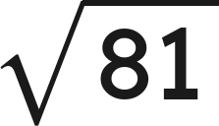
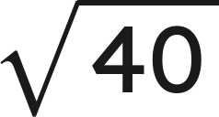

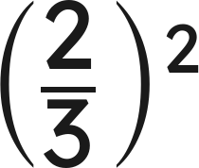
Warm-Up
1.
2. Between which two whole numbers is
?
3. Solve
4. Evaluate
Grade 7 Accelerated · Unit 3 · Lesson 1 — Product Laws of Exponents
2

Slide 3

Warm-Up
1.
9
2. Between which two whole numbers is
?
6 and 7
3. Solve
x = 6
4. Evaluate
Grade 7 Accelerated · Unit 3 · Lesson 1 — Product Laws of Exponents
3

Slide 4
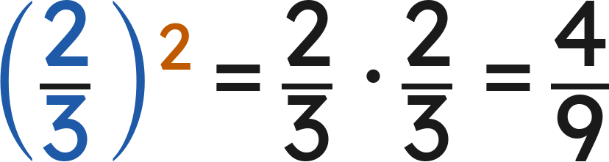

Notes
I. A power is a shorthand for repeated multiplication
A.
base — the number used as a factor
B.
exponent — how many times the base is a factor
C.
power — the whole thing, base and exponent together
Grade 7 Accelerated · Unit 3 · Lesson 1 — Product Laws of Exponents
4

Slide 5
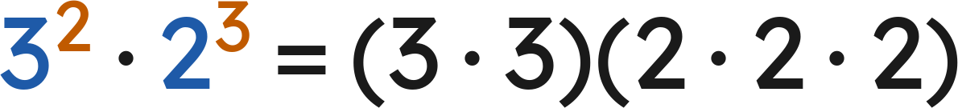

Notes
II. Product of powers — same base, add the exponents
— different bases, no shortcut
Product of powers:
Check with values:
Grade 7 Accelerated · Unit 3 · Lesson 1 — Product Laws of Exponents
5

Slide 6

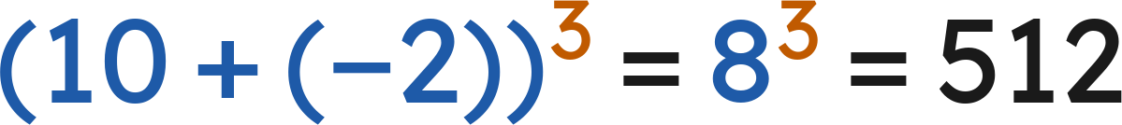
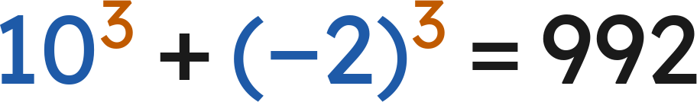
Notes
III. Power of a product — the exponent goes to every factor
Power of a product:
Works for a product only, never for a sum:
but
Grade 7 Accelerated · Unit 3 · Lesson 1 — Product Laws of Exponents
6

Slide 7


Notes
IV. Power of a power, and the exponent 1
Power of a power | Repeated multiplication | Single power
(4²)³ | 4² · 4² · 4² | 4⁶
(10⁴)⁴ | 10⁴ · 10⁴ · 10⁴ · 10⁴ | 10¹⁶
(3¹)⁵ | 3 · 3 · 3 · 3 · 3 | 3⁵
Power of a power:
Identity:
Grade 7 Accelerated · Unit 3 · Lesson 1 — Product Laws of Exponents
7

Slide 8

Example 1
Which law? Then find the value.
Grade 7 Accelerated · Unit 3 · Lesson 1 — Product Laws of Exponents
8

Slide 9

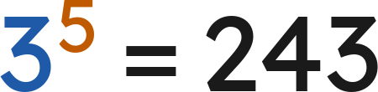

Example 1
Answer: 243
Grade 7 Accelerated · Unit 3 · Lesson 1 — Product Laws of Exponents
9

Slide 10

Your Turn
Which law? Then find the value.
Grade 7 Accelerated · Unit 3 · Lesson 1 — Product Laws of Exponents
10

Slide 11



Your Turn
Which law? Then find the value.
Answer: 2⁷ = 128
Grade 7 Accelerated · Unit 3 · Lesson 1 — Product Laws of Exponents
11

Slide 12
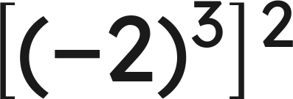
Example 2
Which law? Then find the value.
Grade 7 Accelerated · Unit 3 · Lesson 1 — Product Laws of Exponents
12

Slide 13

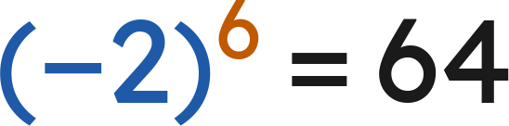
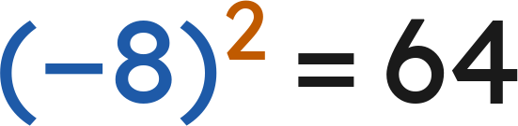
Example 2
Answer: 64
Grade 7 Accelerated · Unit 3 · Lesson 1 — Product Laws of Exponents
13

Slide 14
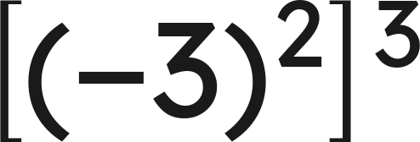
Your Turn
Which law? Then find the value.
Grade 7 Accelerated · Unit 3 · Lesson 1 — Product Laws of Exponents
14

Slide 15


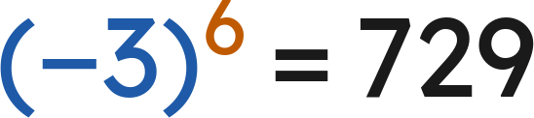
Your Turn
Which law? Then find the value.
Answer: (−3)⁶ = 729
Grade 7 Accelerated · Unit 3 · Lesson 1 — Product Laws of Exponents
15

Slide 16

Whiteboards · Question 1 of 9
Answer it.
Grade 7 Accelerated · Unit 3 · Lesson 1 — Product Laws of Exponents
16

Slide 17



Whiteboards · Question 1 of 9
Answer:
Grade 7 Accelerated · Unit 3 · Lesson 1 — Product Laws of Exponents
17

Slide 18


Whiteboards · Question 2 of 9
A rectangle is
centimeters long and
centimeters wide.
Its perimeter is 40 centimeters.
What is the area of the rectangle, in square centimeters?
Answer it.
Grade 7 Accelerated · Unit 3 · Lesson 1 — Product Laws of Exponents
18

Slide 19




Whiteboards · Question 2 of 9
A rectangle is
centimeters long and
centimeters wide.
Its perimeter is 40 centimeters.
What is the area of the rectangle, in square centimeters?
Area = length × width
Answer: 2⁶ = 64 square centimeters
Grade 7 Accelerated · Unit 3 · Lesson 1 — Product Laws of Exponents
19

Slide 20
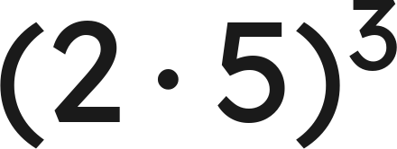
Whiteboards · Question 3 of 9
Answer it.
Grade 7 Accelerated · Unit 3 · Lesson 1 — Product Laws of Exponents
20

Slide 21

Whiteboards · Question 3 of 9
Answer: 1000
Grade 7 Accelerated · Unit 3 · Lesson 1 — Product Laws of Exponents
21

Slide 22
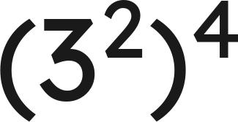
Whiteboards · Question 4 of 9
Answer it.
Grade 7 Accelerated · Unit 3 · Lesson 1 — Product Laws of Exponents
22

Slide 23
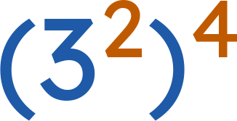


Whiteboards · Question 4 of 9
Answer:
Grade 7 Accelerated · Unit 3 · Lesson 1 — Product Laws of Exponents
23

Slide 24
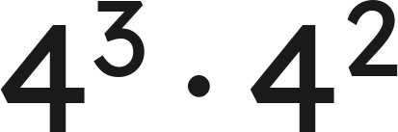
Whiteboards · Question 5 of 9
Which expression is equivalent?
A. 16⁵
B. 8⁵
C. 4⁶
D. 4⁵
Answer it.
Grade 7 Accelerated · Unit 3 · Lesson 1 — Product Laws of Exponents
24

Slide 25


Whiteboards · Question 5 of 9
Which expression is equivalent?
Answer: D — 4⁵
Grade 7 Accelerated · Unit 3 · Lesson 1 — Product Laws of Exponents
25

Slide 26
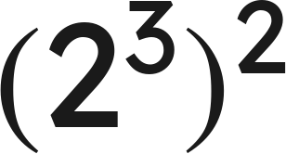
Whiteboards · Question 6 of 9
Which expression is equivalent?
A. 2⁵
B. 4⁶
C. 2⁶
D. 2⁹
Answer it.
Grade 7 Accelerated · Unit 3 · Lesson 1 — Product Laws of Exponents
26

Slide 27
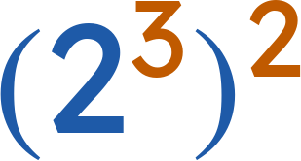

Whiteboards · Question 6 of 9
Which expression is equivalent?
Answer: C — 2⁶
Grade 7 Accelerated · Unit 3 · Lesson 1 — Product Laws of Exponents
27

Slide 28
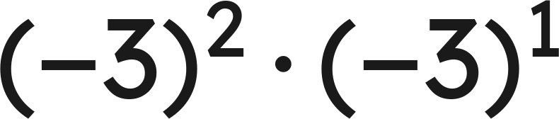
Whiteboards · Question 7 of 9
Answer it.
Grade 7 Accelerated · Unit 3 · Lesson 1 — Product Laws of Exponents
28

Slide 29
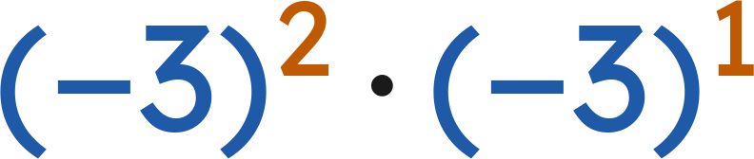
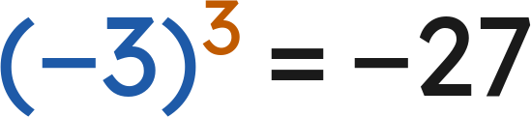
Whiteboards · Question 7 of 9
Answer: −27
Grade 7 Accelerated · Unit 3 · Lesson 1 — Product Laws of Exponents
29

Slide 30
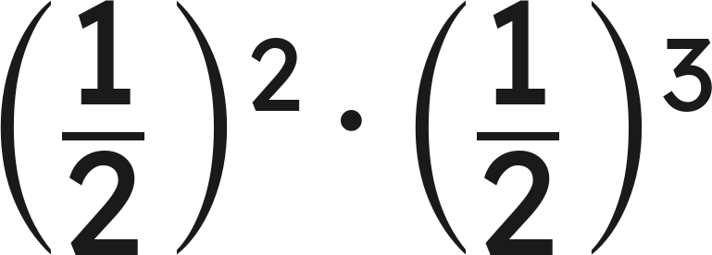
Whiteboards · Question 8 of 9
Answer it.
Grade 7 Accelerated · Unit 3 · Lesson 1 — Product Laws of Exponents
30

Slide 31
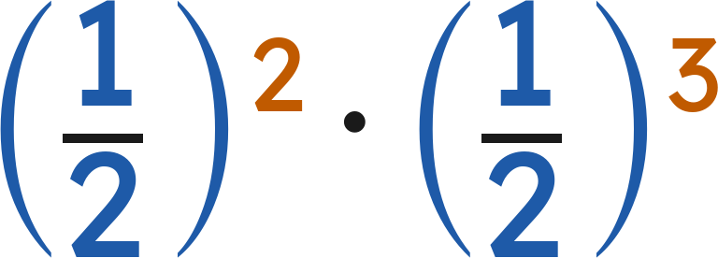
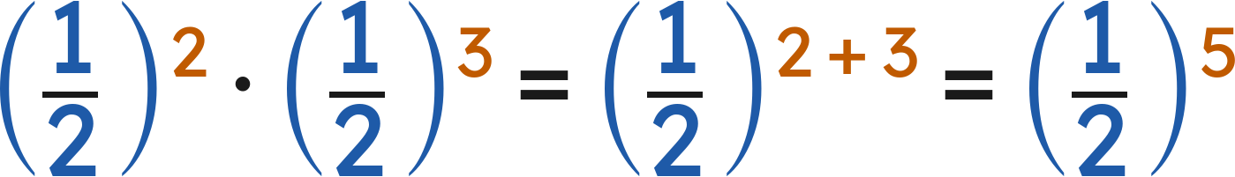
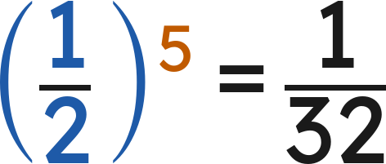

Whiteboards · Question 8 of 9
Answer:
Grade 7 Accelerated · Unit 3 · Lesson 1 — Product Laws of Exponents
31

Slide 32
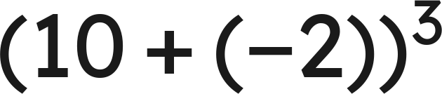
Whiteboards · Question 9 of 9
Aiyanna says she can use the power of a product law
to evaluate
. Is she right?
Write your answer in sentences.
Grade 7 Accelerated · Unit 3 · Lesson 1 — Product Laws of Exponents
32

Slide 33



Whiteboards · Question 9 of 9
Aiyanna says she can use the power of a product law
to evaluate
. Is she right?
Inside the parentheses is a sum, not a product.
Answer: No — (10 + (−2))³ = 8³ = 512
Grade 7 Accelerated · Unit 3 · Lesson 1 — Product Laws of Exponents
33

Slide 34


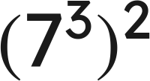
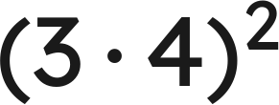
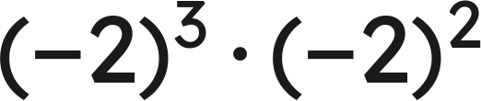


Independent Set
1.
Write as one power.
2.
Find the value.
3.
Write as one power.
4.
Find the value.
5.
Find the value.
6.
Find the value of
.
Grade 7 Accelerated · Unit 3 · Lesson 1 — Product Laws of Exponents
34

Slide 35
IXL
1.
Open IXL and start today's skills.
2.
Work on paper where the question needs work. The answer box does not show it.
3.
Every skill listed is required, to a SmartScore of 67. Due at the start of the next class.
Today's skills — all required
Evaluate powers — SZQ
Multiplication with exponents — 5SK
Power rule — 8DA
Understanding exponents — BFA
Grade 7 Accelerated · Unit 3 · Lesson 1 — Product Laws of Exponents
35

